Slide 1
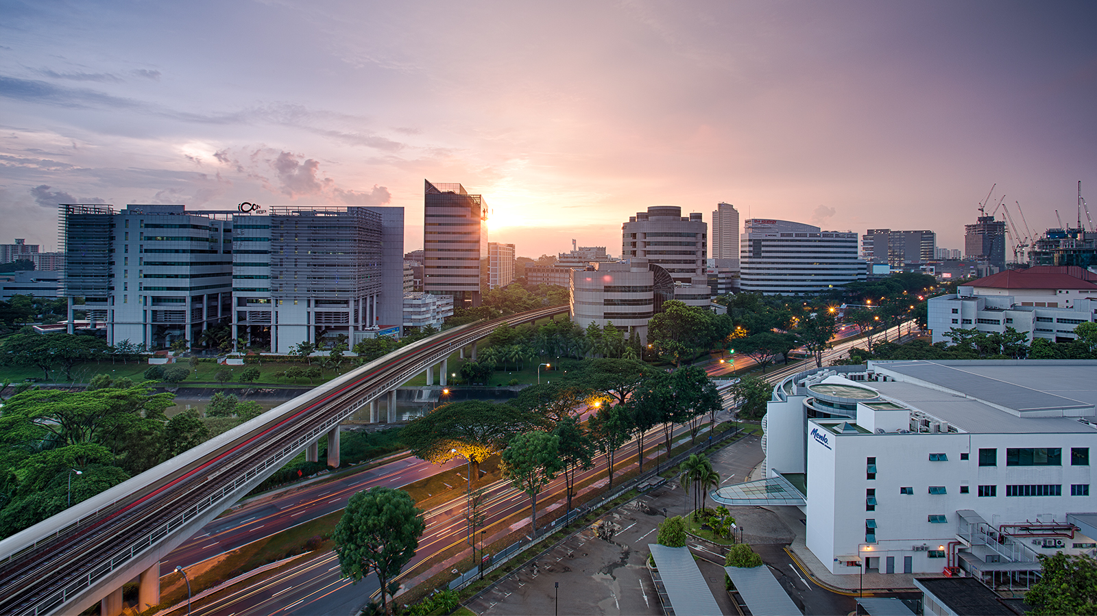
EI Project Demonstration: Public Transport System
Group 3
Eugene Choy Wen Jia Ho Min Kit Winston Ho Wei Hong Sim Li Jin Yin Yukun Yong Fu Xiang
Image retrieved from www.travelweekly-asia.com

Slide 2
Scenario
Public Transport network serves hundred of thousands of passengers everyday. Any disruption in the service would require mitigation actions to be taken to ensure minimal disruptions to the passengers.
A well-integrated public transport network across multiple systems with the various stakeholders will help enhance the communication and automate processes when mitigation actions are required

Slide 3


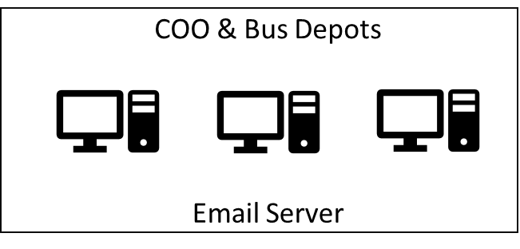




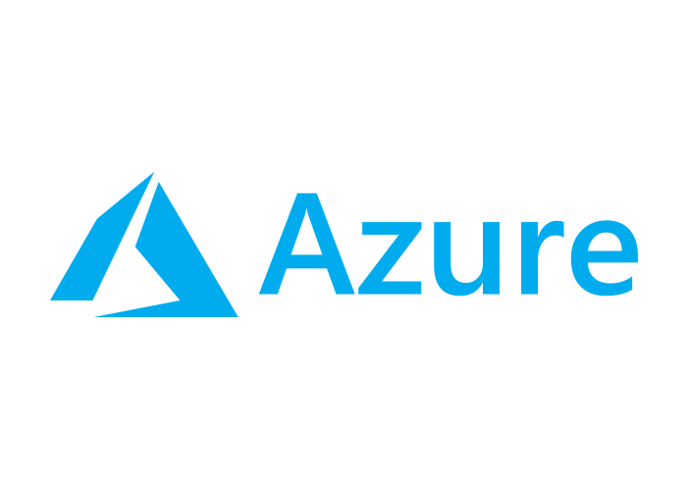




t.weather
t.ns.listener
t.ew.listener
Train Mgmt Messaging System
Break down messages
Heavy Rainfall Report
Train Listeners
Twitter Plugin
t.weather
t.<dynamic>.listener
Send Emails
jdbc
busdepotname
breakdown.xml (new_breakdown.xsd)
TIBCO BW
EMS
q.breakdown
q.deployed
q.depot.<dynamic>
t.weather
t.<dynamic>.listener
P q.breakdown (Q)
P q.deployed
C q.deployed (Q)
File Poller
busRequest.xml (new_busRequest.xsd)
Bus Management System
C q.depot.<dynamic>
HTTP
busdepot
Get nearest Bus Depot
Web Service
HTTP
q.depot.jurong
q.depot.tampines
q.depot.toapayoh
HTTP
Schedule Management
Web Service (PHP)
Weather API
(wrapped NEA Api w code)
Bus Depots Deploy Mgmt System

Slide 4
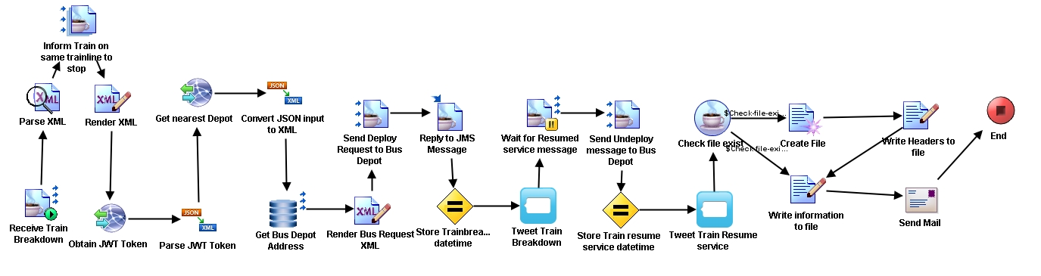

Slide 5
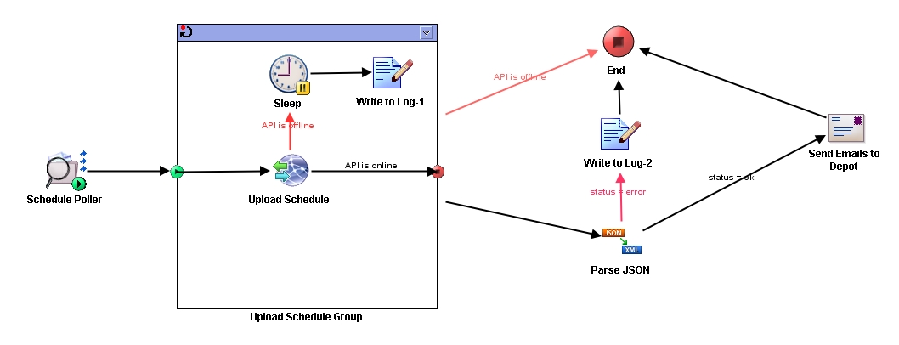

Slide 6
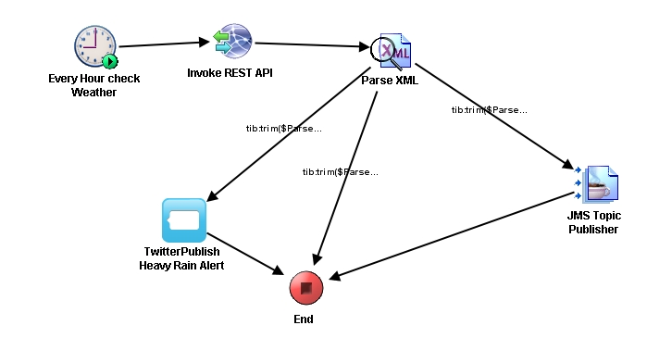

Slide 7
Integration across…
3 hosted environments
(Microsoft Azure, Heroku, localhost)
4 programming languages
(C#, Java, PHP, Python)
7 out-of-classroom TIBCO BW palette
(Waiting for JMS message, Assigning variable on IM, Twitter Plugin, Send Mail Plugin, Timer Plugin, File Poller Plugin, Grouping Repeat-On-Error-Till-True)

